Slide 1
Biodiversity and conservation

Slide 2
Biodiversity: the variability among living organisms from all sources including, terrestrial, marine and other aquatic ecosystems and the ecological complexes of which they are part; this includes diversity within species, between species and of ecosystems or
Biodiversity can be defined as the totality of genes, species and ecosystems of a given region. • This term was coined by EDWARD WILSON
Levels of biodiversity:
Biodiversity can be studied at- 1. Genetic diversity 2. Species diversity 3. Ecological/Ecosystem diversity

Slide 3
Genetic diversity
It describes the variation in the number and types of genes as well as chromosomes present in different species. The magnitude of variation in genes of a species increases with increase in size and environmental parameters of the habitat.
The genetic variation arises by gene and chromosome mutation in individuals and in sexually reproducing organisms and it is spread in the population by recombination of genetic materials during cell division after sexual reproduction
Genetic diversity has the following importance:
(i) It helps in speciation or evolution of new species;
(ii) It is useful in adaptation to changes in environmental conditions;
(iii) It is important for agricultural productivity and development.

Slide 4
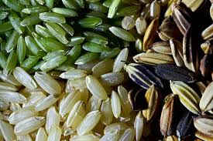
Genetic diversity
the level of biodiversity, refers to the total number of genetic characteristics in the genetic makeup of a species. It is distinguished from genetic variability, which describes the tendency of genetic characteristics to vary .
At finer levels of organisation, biodiversity includes the genetic variation within species, both among geographically separated populations and among individuals within single population.
Genetic diversity serves as a way for populations to adapt to changing environments. With more variation, it is more likely that some individuals in a population will possess variations of alleles that are suited for the environment. Those individuals are more likely to survive to produce offspring bearing that allele. The population will continue for more generations because of the success of these individuals
Greater the genetic diversity among organisms of a species, more sustenance it has against environmental perturbations.
• Genetically uniform populations are highly prone to disease harsh environment.
• Rauwolfia vomitoria shows genetic variation in terms of concentration and potency of chemical reserpine
• There are more than 50,000 varieties of rice and nearly 1000 varieties of mangoes.

Slide 5
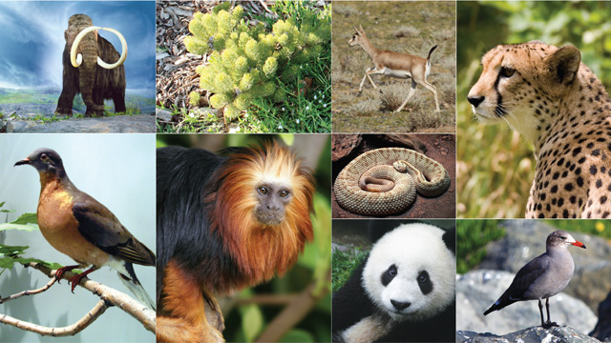
Species diversity
Species diversity It describes the variety in the number and richness of the spices with in a region. The species richness may be defined as the number of species per unit area. The richness of a species tells about the extent of biodiversity of a site and provides a means for comparing different sites.
The species richness depends largely on climatic conditions. The number of individuals of different species with in a region represents species evenness or species equitability. The product species richness and species evenness give species diversity of a region. When a species is confined entirely to a particular area, it is termed as endemic species.

Slide 6
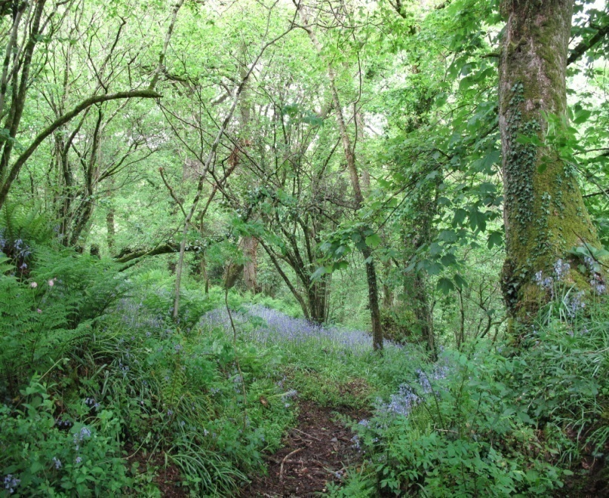
Ecosystem diversity
Ecosystem diversity refers to the diversity of a place at the level of ecosystems. It describes the assemblage and Interaction of spices living together and the physical environment a given area. It relates varieties of habitats, biotic communities ecological processes in biosphere. It also tells about the diversity within the ecosystem. It is referred as Land escape diversity because it includes placement and size of various ecosystems.
For example, the landscapes like grass lands, deserts, mountains etc. show ecosystem diversity. The ecosystem diversity is due to diversity of niches, trophic levels and ecological processes like nutrient cycling, food webs, energy flow, role of dominant species and various related biotic interactions. Such type of diversity can generate more productive and stable ecosystems or communities capable of tolerating various types of stresses e.g. drought, flood etc.

Slide 7
According to Whittaker (1965), the community diversities are of three types:
(i) α-Diversity:
It tells the species diversity in a given community.
It depends upon species richness and evenness.
(ii) β-Diversity:
It describes a range of communities due to replacement of species which arises due to the presence of different microhabitats, niches and environmental conditions.
(iii) γ -Diversity:
It describes diversity of habitat over a total land escape or geographical area.

Slide 8
Distribution of diversity
The distribution of species around the globe is not random. There are some general principles that will help make sense of species diversity trends. In general, if we have more energy in the system, relatively easy environmental conditions, and a lot of evolutionary time we will see a greater diversity of species largely due to many species being able to become specialized.
Where there is a diversity of habitats we will also, in general, see more species because each habitat or ecosystem has its own community of species.
Different habitats translate into different sets of selection pressures that push natural selection.
On a smaller scale where two or more habitats meet, an edge, we tend to see more overall species diversity due to the overlap of communities of species.
For example, a narrow strip of land next to the ocean on one side and next to mountains on the other may show high levels of biodiversity in a given area, because we might be at the edge of a coastal marine habitat, grassland and forest habitats, and mountain habitat all in a small area.
The species of each of those habitats may, therefore, be present together in a given place especially if they are mobile, i.e. birds.

Slide 9
Distribution along Latitudinal gradients
The diversity of plants and animals is not uniform throughout the world but shows a rather uneven distribution. For many group of animals or plants, there are interesting patterns in diversity, the most well- known being the latitudinal gradient in diversity. In general, species diversity decreases as we move away from the equator towards the poles. With very few exceptions, tropics (latitudinal range of 23.5° N to 23.5° S) harbour more species than temperate or polar areas. Colombia located near the equator has nearly 1,400 species of birds while New York at 41° N has 105 species and Greenland at 71° N only 56 species. India, with much of its land area in the tropical latitudes, has more than 1,200 species of birds. A forest in a tropical region like Equador has up to 10 times as many species of vascular plants as a forest of equal area in a temperate region like the Midwest of the USA. The largely tropical Amazonian rain forest in South America has the greatest biodiversity on earth- it is home to more than 40,000 species of plants, 3,000 of fishes, 1,300 of birds, 427 of mammals, 427 of amphibians, 378 of reptiles and of more than 1,25,000 invertebrates. Scientists estimate that in these rain forests there might be at least two million insect species waiting to be discovered and named.

Slide 10
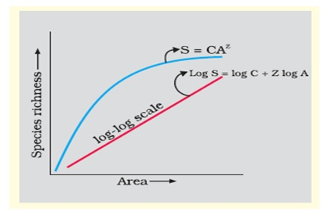
Species-Area relationships
Alexander von Humboldt observed that within a region species richness increased with increasing explored area, but only up to a limit. In fact, the relation between species richness and area for a wide variety of taxa (angiosperm plants, birds, bats, freshwater fishes) turns out to be a rectangular hyperbola. On a logarithmic scale, the relationship is a straight line described by the equation
log S = log C + Z log A
where S= Species richness A= Area Z = slope of the line (regression coefficient) C
Ecologists have discovered that the value of Z lies in the range of 0.1 to 0.2, regardless of the taxonomic group or the region (whether it is the plants in Britain, birds in California or molluscs in New York state, the slopes of the regression line are amazingly similar). But, if we analyse the species-area relationships among very large areas like the entire continents, we will find that the slope of the line to be much steeper (Z values in the range of 0.6 to 1.2)

Slide 11
Biodiversity of India:
As per available data, the varieties of species living on the earth are 1753739. Out of the above species, 134781 are residing in India although surface area of India is 2% of the earth’s surface. Wild life Institute of India has divided it into ten biogeographical regions and twenty five biotic provinces.
Biogeographical regions are:
(i) Trans Himalayas,
(ii) Gangetic plain,
(iii) Desert,
(iv) Semiarid zone;
(v) Western Ghats;
(vi) Deccan peninsula,
(vii) North eastern zone,
(viii) Coastal lands
(ix) Himalayas,
(x) Islands.

Slide 12
India is one of the twelve mega diversity nations of the world due to the following reasons:
(i) It has 7.3% of the global fauna and 10.88% of global flora as per the data collected by Ministry of Environment and forest.
(ii) It has 350 different mammals, 1200 species of birds- 453 different reptiles, 182 amphibians and 45,000 plants spices.
(iii) It has 50,000 known species of insects which include 13,000 butterflies and moths.
(iv) It has 10 different biogeographical regions and 25 biotic provinces having varieties of lands and species.
(v) In addition to geographical distribution, geological events in the land mass provide high level of biological diversity.
(vi) Several crops arose in the country and spread throughout the world.
(vii) There is wide variety of domestic animals like cows, buffaloes, goats, sheep, pigs, horses etc.
(viii) The marine biota includes sea weeds, fishes, crustaceans, molluses, corals, reptiles etc.
(ix) There are a number of hot spots (namely Eastern Ghats, Western Ghats, North Eastern hills etc.).

Slide 13
Importance of Biodiversity
The living organisms on earth are of great diversity, living in diverse habitats and possessing diverse qualities and are vital to human existence providing food, shelter, clothing’s, medicines etc.
The biodiversity has the following importance’s:
1. Productive values:
Biodiversity produces a number of products harvested from nature and sold in commercial markets. Indirectly it provides economic benefits to people which include water quality soil protection, equalisation of climate, environmental monitoring, scientific research, recreation etc.
2. Consumptive value:
The consumptive value can be assigned to goods such as fuel woods, leaves, forest products etc. which may be consumed locally and do not figure in national and international market.
3. Social value:
The loss of biodiversity directly influences the social life of the country possibly through influencing ecosystem functions (energy flow and biogeochemical cycle). This be easily understood by observing detrimental effects of global warming and acid rain which cause an unfavorable alteration in logical processes.
4. Aesthetic value:
Aesthetic values such as refreshing fragrance of the flowers, taste of berries, softness of mossed, melodious songs of birds, etc. compel the human beings to preserve them. The earth’s natural beauty with its colour and hues, thick forest, and graceful beasts has inspired the human beings from their date of birth to take necessary steps for its maintenance. Similarly botanical and zoological gardens are the means of biodiversity conservation and are of aesthetic values.

Slide 14
5. Legal values:
Since earth is homeland of all living organisms, all have equal right to coexist on the surface of earth with all benefits. Unless some legal value is attached to biodiversity, it will not be possible to protect the rapid extinction of species.
6. Ethical value:
Biodiversity must be seen in the light of holding ethical value. Since man is the most intelligent amongst the living organisms, it should be prime responsibility and moral obligation of man to preserve and conserve other organisms which will directly or indirectly favour the existence of the man.
7. Ecological value:
Biodiversity holds great ecological value because it is indispensable to maintain the ecological balance. Any disturbance in the delicately fabricated ecological balance maintained by different organisms, will lead to severe problems, which may threaten the survival of human beings.
8. Economic value:
Biodiversity has great economic value because economic development depends upon efficient and economic management of biotic resources.
In the day to day life, human beings are maintaining their lifestyle at the sacrifice of surrounding species which come from diversity of plants and animals struggling for their existence.
So, it is highly essential for the human beings to take care of their surrounding species and make optimum use of their service, for better economic development. Thus, it is rightly told, survival of the man depends upon the survival of the biosphere.

Slide 15
Uses of Biodiversity
Biodiversity has the following uses for the development humanity:
(i) It provides food of all types.
(ii) It provides fibers, sources for the preparation of clothes.
(iii) It provides different types of oil seeds for the preparation of oils.
(iv) It provides new varieties of rice, potato etc. through the process of hybridization.
(v) It provides different drugs and medicines which are based on different plant products.
(vi) It is very essential for natural pest control, maintenance of population of various species, pollination by insects and birds, nutrient cycling, conservation and purification of water, formation of soil etc. All these services together are valued 16.54 trillion dollars per year.

Slide 16
Threats to Biodiversity
Biodiversity is considered as a reservoir of resources to be used for the manufacture of food, medicine, industrial products, etc. But with an increased demand of rapid population growth, biodiversity is gradually depleting. A number of plants” and ani­mal species have already become extinct and many are endan­gered.
The different factors responsible for causing threat to biodiversity are as follows:
1. Habitat destruction:
The primary cause of loss of biodiversity is habitat loss or destruction which is resulted due to the large industrial and commercial activities associated with agriculture, irrigation, construction of dams, mining, fishing etc.
2. Habitat fragmentation:
With increased population, the habitats are fragmented into pieces by roads, fields, canals, power lines, towns etc. The isolated fragment of habitats restricts the potential of species for dispersal and colonization. In addition, the habitat fragmentation also brings about microclimatic changes in light, temperature, wind etc.
3. Pollution:
The most dreaded factor inducing loss of biodiversity is environmental pollution which include air pollution, Water pollution, industrial pollution, pollution due to chemical Pastes, pesticides radioactive materials etc.

Slide 17
4. Over exploitation:
The natural resources are over exploited to meet growing rural poverty, intensive technological growth and globalization of economy. All these factors together may be responsible for the extinction of a number of species.
5. Introduction of exotic species:
The introduction of exotic species are due to:
(i) horticulture
(ii) agriculture;
(iii) European colonisation and
(iv) accidental transport.
It is seen that some exotic species may kill or eat the native species thereby causing its extinction.
6. Diseases:
Since the animals are more vulnerable to infection, the anthropological activities may increase the incidence of diseases in wild species, leading to their extinction.
7. Shifting or Jhum cultivation:
The shifting or Jhum cultivation by poor tribal people greatly affects the forest structure which is a store house of biodiversity.
8. Poaching of wild life:
A number of wildlife species are becoming extinct due to poaching and hunting.

Slide 18
Conservation of Biodiversity
Biodiversity is being depleted by the loss of habitat, fragmentation of habitat, over exploitation of resources, human sponsored ecosystems, climatic changes, pollution invasive exotic spices, diseases, shifting cultivation, poaching of wild life etc.
Since the human beings are enjoying all the benefits from biodiversity, they should take proper care for the preservation of biodiversity in all its form and good health for the future generation i.e., the human being should prevent the degradation and destruction of the habitats thereby maintaining the biodiversity at its optimum level.
Conservation of biodiversity is protection, upliftment and scientific management of biodiversity so as to maintain it at its threshold level and derive sustainable benefits for the present and future generation. In other words, conservation of bio-diversity is the proper management of the biosphere by human beings in such a way that it gives maximum benefits for the present generation and also develops its potential so as to meet the needs of the future generations.
Mainly the conservation of biodiversity has three basic objectives:
(a) To maintain essential ecological processes and life supporting systems.
(b) To preserve the diversity of species.
(c) To make sustainable utilisation of species and ecosystems.

Slide 19
Strategies for Conservation of Biodiversity
The following strategies should be undertaken in order to con­serve biodiversity:
(1) All the possible varieties (old or new) of food, forage and timber plants, live stock, agriculture animals and microbes should be conserved.
(2) All the economically important organisms in protected areas should be identified and conserved.
(3) Critical habitats for each species should be identified and safeguarded.
(4) Priority should be given to preserve unique ecosystems.
(5) There should be sustainable utilisation of resources.
(6) International trade in wild life should be highly regulated.
(7) The poaching and hunting of wildlife should be prevented as far as practicable.
(8) Care should be taken for the development of reserves and protected areas.
(9) Efforts should be made to reduce the level of pollutants in the environment.
(10) Public awareness should be created regarding biodiversity and its importance for the living organisms.
(11) Priority should be given in wildlife conservation programme to endangered species over vulnerable species and to vulnerable species over rare species.
(12) The habitats of migratory birds should be protected by bilateral and multilateral agreement.
(13) The over exploitation of useful products of wild life should be prevented.
(14) The useful animals, plants and their wild relatives should be protected both in their natural habitat (in-situ) and in zoological botanical gardens (ex-situ)
(15) Efforts should be made for setting up of National parks and wild life sanctuaries to safeguard the genetic diversity and their continuing evolution.
(16) Environmental laws should be strictly followed.

Slide 20
Conservation Methods
There are two types of conservation methods namely in-situ and ex-situ conservations.
a) In situ conservation:
The conservation of species in their natural habitat or natural ecosystem is known as in situ conservation. In the process, the natural surrounding or ecosystem is protected and maintained so that all the constituent species (known or unknown) are conserved and benefited. The factors which are detrimental to the existence of species concerned are eliminated by suitable mechanism.
The different advantages of in situ conservation are as follows:
(a) If is a cheap and convenient way of conserving biological diversity.
(b) It offers a way to preserve a large number of organisms simultaneously, known or unknown to us.
(c) The existence in natural ecosystem provides opportunity to the living organisms to adjust to differed’ environmental conditions and to evolve in to a better life form.
The only disadvantage of in situ conservation is that it requires large space of earth which is often difficult because of growing demand for space. The protection and management of biodiversity through in situ conservation involve certain specific areas known as protected areas which include national parks, Sanctuaries and Biosphere reserves.

Slide 21
Protected areas
The protected areas are biogeographical areas where biological diversity along with natural and cultural resources are protected, maintained and managed through legal and administrative measures. The demarcation of biodiversity in each area is determined on the basis of climatic and physiological conditions.
In these areas, hunting, firewood collection, timber harvesting etc. are prohibited so that the wild plants and animals can grow and multiply freely without any hindrance. Some protected areas are: Cold desert (Ladakh and Spiti), Hot desert (Thar), Saline Swampy area (Sunderban and Rann of Kutch), Tropical moist deciduous forest (Western Ghats and north East) etc. Protected areas include national parks, sanctuaries and biosphere reserves. There are 37,000 protected areas throughout the world. As per World Conservation Monitoring Centre, India has 581 protected areas, national parks and sanctuarie

Slide 22
National parks
These are the small reserves meant for the protection of wild life and their natural habitats. These are maintained by government. The area of national parks ranges between 0.04 to 3162 km. The boundaries are well demarcated and circumscribed. The activities like grazing forestry, cultivation and habitat manipulation are not permitted in these areas. There are about 89 national parks in India.
Some important national Parks of India are:
(i) Biological Park, Nandankanan, Orissa,
(ii) Corbett national Park Nainital, U.P. (First national Park)
(iii) Koziranga national Park, Jorhat, Assam
(iv) Tudula national Park, Maharashtra
(v) Hazaribagh national Park, Hazaribagh, Bihar
(vi) Band havgarh national park, M.P.
(vii) Bandipur national park, Karnataka.
(viii) Kanha National Park, M.P.
(ix) Reibul Lamjao National Park, Manipur
(x) Nawgaon National Park, Maharashtra

Slide 23
Sanctuaries
These are the areas where only wild animals (fauna) are present. The activities like harvesting of timbers, collection of forest products, cultivation of lands etc. are permitted as long as these do not interfere with the project. That is, controlled biotic interference is permitted in sanctuaries, which allows visiting of tourists for recreation. The area under a sanctuary remains in between 0.61 to 7818 km.
Some important sanctuaries of Orissa are as follows:
(i) Nandankanan Zoological Park
(ii) Chandaka Elephant reserve
(iii) Simlipal Tiger Reserve
(iv) Bhitarkanika Wild life Sanctuary
(v) Gharial project at Tikarpada
(vi) Chilika (Nalaban) Sanctuary

Slide 24
Biosphere reserves
Biosphere reserves or natural reserves are multipurpose protected areas with boundaries circumscribed by legislation. The main aim of biosphere reserve is to preserve genetic diversity in representative ecosystems by protecting wild animals, traditional life style of inhabitant and domesticated plant/ animal genetic resources. These are scientifically managed allowing only the tourists to visit.
Some importance of biosphere reserves are as follows:
(a) These help in the restoration of degraded ecosystem.
(b) The main role of these reserves is to preserve genetic resources, species, ecosystems, and habitats without disturbing the habitants.
(c) These maintain cultural, social and ecologically sustainable economic developments.
(d) These support education and research in various ecological aspects,
Some important biosphere reserves are:
Simlipal, (Orissa), Sunderban (West Bengal), Kanha (M.P Kaziranga (Assam) etc. The biosphere reserve net work was intro­duced by UNESCO 1971.

Slide 25
Ex-situ conservation
Ex-situ conservation involves maintenance and breeding of endangered plants and animals under partially or wholly control­led conditions in specific areas like zoo, gardens, nurseries etc. That is, the conservation of selected plants and animals in se­lected areas outside their natural habitat is known as ex-situ con­servation.
The stresses on living organisms due to competition for food, water, space etc. can be avoided by ex-situ conservation there by providing conditions necessary for a secure life and breeding.
Some important areas under these conservation are:
(i) Seed gene bank,
(ii) Field gene bank;
(iii) Botanical gardens;
(iv) Zoos.
(v)Cryopreservation
(vi)Tissue culture bank

Slide 26
Seed gene bank:
These are cold storages where seeds are kept under controlled temperature and humidity for storage and this is easiest way to store the germ plasma of plants at low temperature. Seeds preserved under controlled conditions (minus temperature) remain viable for long durations of time.
ii. Gene bank:
Genetic variability also is preserved by gene bank under normal growing conditions. These are cold storages where germ plam are kept under controlled temperature and humidity for storage; this is an important way of preserving the genetic resources.
iii. Cryopreservation:
This is the newest application of technology for preservation of biotic parts. This type of conservation is done at very low temperature (196°C) in liquid nitrogen. The metabolic activities of the organisms are suspended under low temperature, which are later used for research purposes.
iv. Tissue culture bank:
Cryopreservation of disease free meristems is very helpful. Long term culture of excised roots and shoots are maintained. Meristem culture is very popular in plant propagation as it’s a virus and disease free method of multiplication.

Slide 27
v. Long term captive breeding:
The method involves capture, maintenance and captive breeding on long term basis of individuals of the endangered species which have lost their habitat permanently or certain highly unfavorable conditions are present in their habitat.
vi. Botanical gardens:
A botanical garden is a place where flowers, fruits and vegetables are grown. The botanical gardens provide beauty and calm environment. Most of them have started keeping exotic plants for educational and research purposes.
vii. Animal Translocation:
Release of animals in a new locality which come from anywhere else.
Translocation is carried in following cases:
1. When a species on which an animal is dependent becomes rare.
2. When a species is endemic or restricted to a particular area.
3. Due to habit destruction and unfavorable environment conditions.
4. Increase in population in an area.
viii. Zoological Gardens:
In zoos wild animals are maintained in captivity and conservation of wild animals (rare, endangered species). The oldest zoo, the Schonbrumm zoo which exists today also, was established in VIENNA in 1759.
In India, the 1st zoo came into existence at BARRACKPORE in 1800. In world there are about 800 zoos. Such zoos have about 3000 species of vertebrates. Some zoos have undertaken captive breeding programmes.

Slide 28
The strategies for ex-situ conservations are:
(i) Identification of species to be conserved.
(ii) Adoption of Different ex-situ methods of conservation.
(i) Long-term captive breeding and propagation for the species which have lost their habitats permanently.
(ii) Short-term propagation and release of the animals in their natural habitat
(iii) Animal translocation
(iv) Animal reintroduction
(v) Advanced technology in the service of endangered species

Slide 29
The different advantages of ex-situ conservation are:
It gives longer life time and breeding activity to animals.
It is useful for declining population of species.
Endangered animals on the verge of extinction are successfully breeded.
Threatened species are breeded in captivity and then released in the natural habitats.
Ex-situ centers offer the possibilities of observing wild animals, which is otherwise not possible.
It is extremely useful for conducting research and scientific work on different species.
Some disadvantages of this method are:
(a) The favourable conditions may not be maintained always.
(b) Mew life forms cannot evolve.
(c) This technique involves only few species.

Slide 30
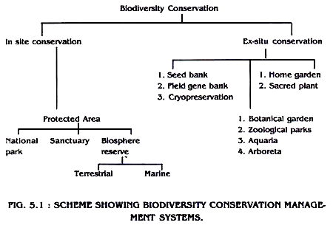

Slide 31
Biodiversity hotspots
Biodiversity hotspots are areas that support natural ecosystems that are largely intact and where native species and communities associated with these ecosystems are well represented. They are also areas with a high diversity of locally endemic species, which are species that are not found or are rarely found outside the hotspot.
The concept of biodiversity hotspots was given by Norman Myers.
To qualify as a hotspot, a region must meet two strict criteria:
It must contain at least 1,500 species of vascular plants (> 0.5 percent of the world’s total) as endemics.
It has to have lost at least 70 percent of its original habitat.
Three factors that usually determine hotspots:
The number of total species (species richness).
The number of unique species (endemism).
The number of species at risk (threat of extinction).

Slide 32
34 biodiversity hotspots have been identified.
They once covered 15.7 percent of the Earth’s land surface.
86 % of the hotspots’ habitat has already been destroyed.
The intact remnants of the hotspots now cover only 2.3 % of the Earth’s land surface.
They contain 150,000 plant species as endemics, 50 %of the world’s total.
Terrestrial vertebrates endemic to the hotspots: 11,980, representing 42 percent of all terrestrial vertebrate species.
Reptiles and amphibians, are more prone to hotspot endemism than are the more wide-ranging mammals and birds, but the overall similarity between taxonomic groups is remarkable.
Overall, 22,022 terrestrial vertebrate species call the hotpots home, 77 percent of the world's total.

Slide 33
World’s 35 Biodiversity Hotspots
I. Africa
Cape Floristic Region
Coastal Forests of Eastern Africa
Eastern Afromontane
Guinean Forests of West Africa
Horn of Africa
Madagascar and the Indian Ocean Islands
Maputaland-Pondoland-Albany
Succulent Karoo
II. Asia-Pacific
East Melanesian Islands
Himalaya
Indo-Burma
Japan
Mountains of Southwest China
New Caledonia
New Zealand
Philippines
Polynesia-Micronesia
Southwest Australia
Forests of Eastern Australia (new)
Sundaland
Wallacea
Western Ghats and Sri Lanka
III. Europe and Central Asia
Caucasus
Irano-Anatolian
Mediterranean Basin
Mountains of Central Asia
IV. North and Central America
California Floristic Province
Caribbean Islands
Madrean Pine-Oak Woodlands
Mesoamerica
V. South America
Atlantic Forest
Cerrado
Chilean Winter Rainfall-Valdivian Forests
Tumbes-Chocó-Magdalena
Tropical Andes

Slide 34
BIODIVERSITY HOTSPOTS IN INDIA
Himalaya: Includes the entire Indian Himalayan region (and that falling in Pakistan, Tibet, Nepal, Bhutan, China and Myanmar)
Indo-Burma: Includes entire North-eastern India, except Assam and Andaman group of Islands (and Myanmar, Thailand, Vietnam, Laos, Cambodia and southern China)
Sundalands: Includes Nicobar group of Islands (and Indonesia, Malaysia, Singapore, Brunei, Philippines)
Western Ghats and Sri Lanka: Includes entire Western Ghats (and Sri Lanka)

Slide 35
Why biodiversity is rich in tropics
Tropical area
Tropical region is the part of earth surrounding the equator.
Exactly it cover the region between tropic of cancer and tropic of capricorn.
Tropical regions receive maximum sunlight over the year
Tropical vegetation are the most productive vegetation on earth.
Tropical areas are rich in biodiversity.
Majority of endemic species of he earth belongs to tropical areas.
Majority of Mega-biodiversity centers and Mega- biodiversity hot- spots are in tropics
Why biodiversity is rich
Tropical areas are rich in biodiversity than temperate regions , because
Warm temperature and high humidity of tropical region are favorable for most of the species on earth.
Tropical area have more stable climate than temperate regions.
Tropical communities of plants and animals are older than temperate communities. Thus tropical communities got more time to evolve.
Tropical communities have more specialization for adaptations
In tropical areas, there is greater pressure from pest, parasites and diseases. This do not allow a single species to predominate.
Tropical areas receive more solar energy over the year than temperate region . Thus tropical communities are more productive than temperate communities
Tropical soil is most fertile soil in the biosphere. This rich soil support a wider range of species.

Slide 36
Measuring biodiversity
Diversity can be defined as the number of species found in a community, a measure known as species richness.
Mathematical indices of biodiversity have been developed to calculate species diversity at different geographical scales as follows:
Alpha diversity: This refers to number of species in a single community. This diversity comes closest to the popular concept of species richness and can be used to compare the number of species in different ecosystem types.
Beta diversity: This refers to the degree to which species composition changes along an environmental gradient. Beta diversity is high for example, if the species composition of moss communities changes at successively higher elevations on a mountain slope, but is low if the same species occupy the whole mountain side.
Gamma diversity: This applies to larger geographical scales and defined as the rate at which additional species are encountered as geographical replacements within a habitat type in different localities. Thus gamma diversity ias a species turnover rate with distance between sites of similar habitat or with expanding geographic areas.

Slide 37
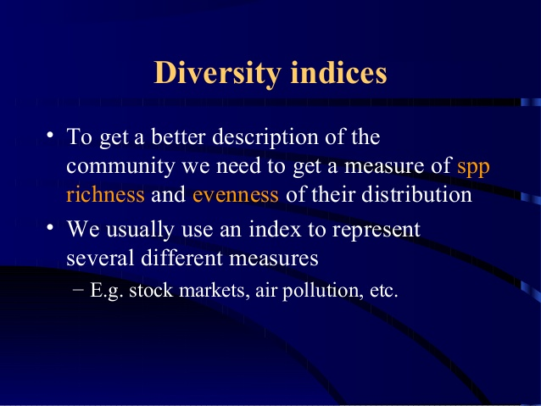

Slide 38
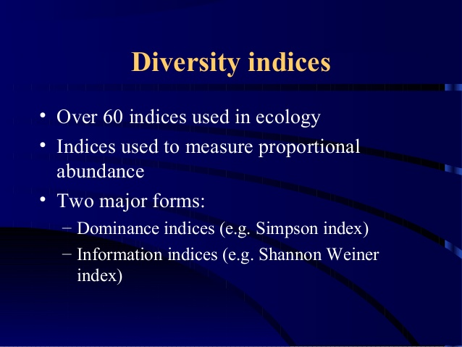

Slide 39
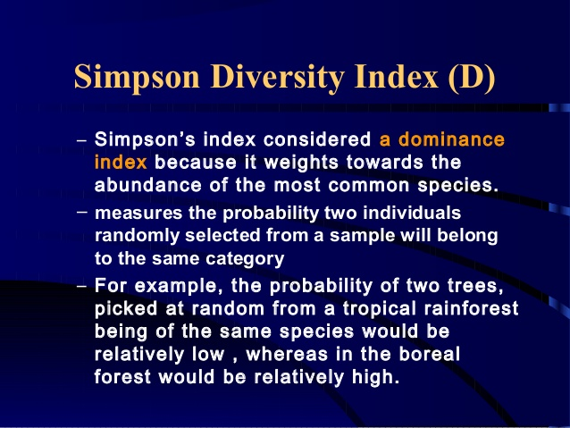

Slide 40
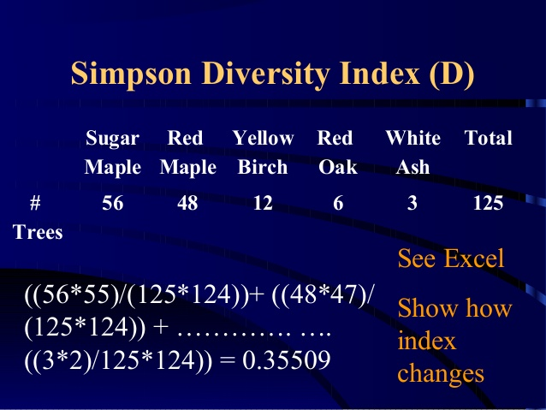

Slide 41
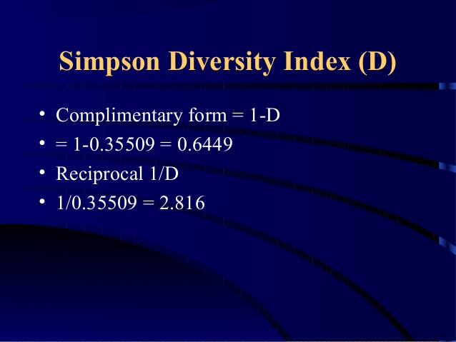

Slide 42
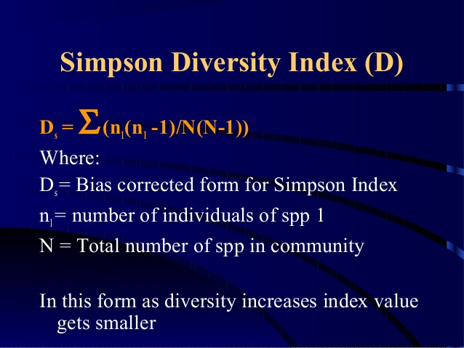

Slide 43
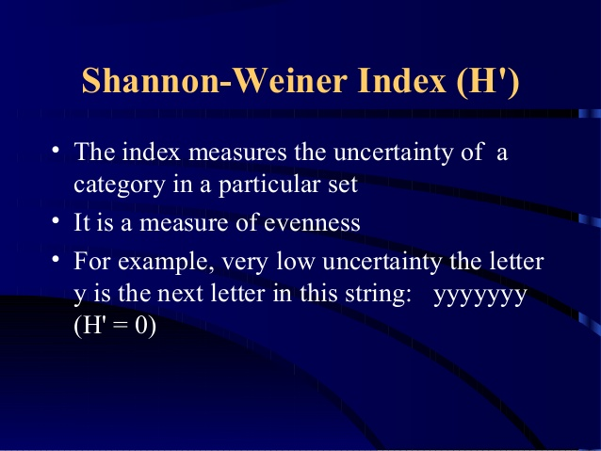

Slide 44
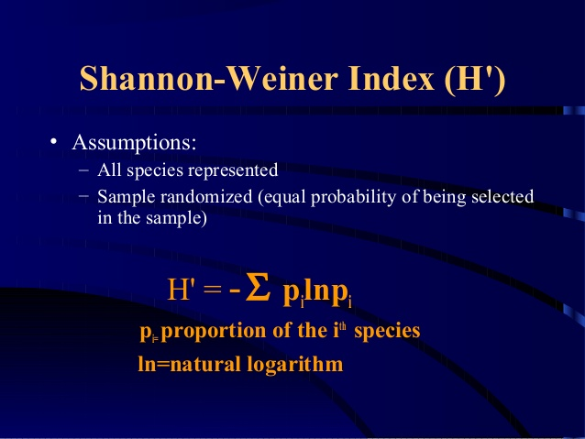

Slide 45
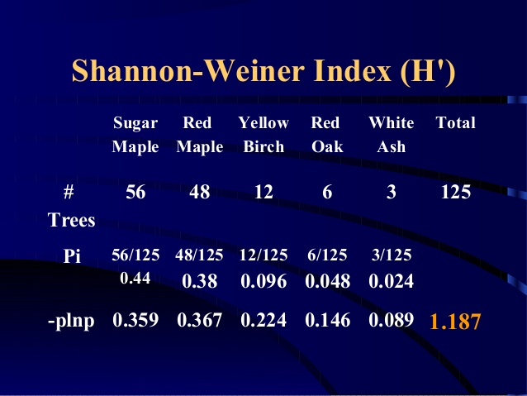

Slide 46
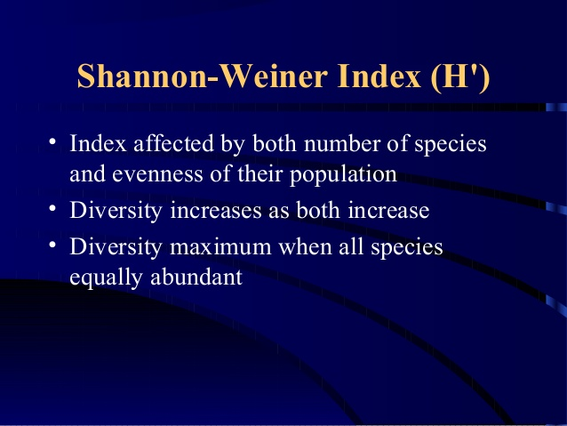

Slide 47
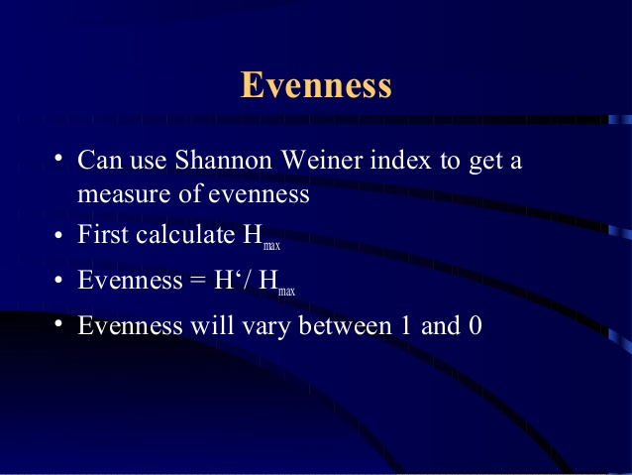

Slide 48
